Slide 1
Receipt & Invoice Digitizer
Tech: Streamlit | OpenCV | Tesseract | Gemini | SQLite | Plotly
Prepared by: DivyaSri Yaganti

Slide 2
Problem Statement
Receipts and invoices are mostly stored as paper/images
Manual record keeping leads to:
loss of bills
difficulty in tracking expenses
time-consuming data entry
Businesses and individuals need a tool to automate digitization and expense analytics

Slide 3
Project Objective
The system aims to:
Convert invoices/receipts into structured digital records
Extract key information like:
  vendor name, date, items, tax, total
Ensure correctness using validation
Store records for future use
Provide insights via dashboard analytics

Slide 4
Key Features
✅ Upload receipt/invoice in Image or PDF format
✅ Automatic OCR text extraction
✅ Gemini AI converts text into structured JSON
✅ Validation check before saving
✅ Duplicate invoice detection
✅ Dashboard with spending analytics
✅ History management with delete/reset option

Slide 5
Technology Stack
UI & Application
Streamlit (interactive multi-page web app)
OCR & Processing
OpenCV (enhancing images)
Tesseract OCR (text extraction)
AI Extraction
Gemini API (structured invoice output)
Storage & Analytics
SQLite database (vault.db)
Pandas + Plotly (charts & reports)

Slide 6
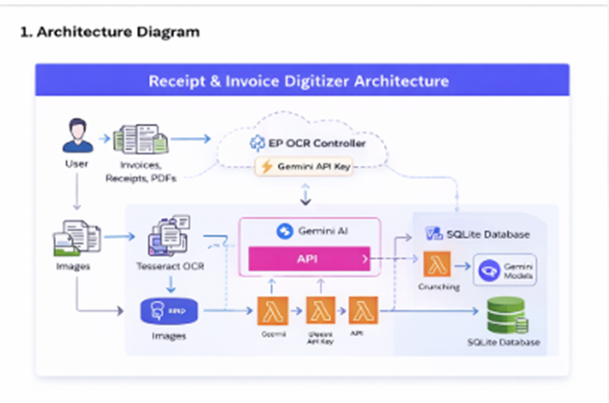
System Architecture (High Level)
Upload → Preprocess → OCR → AI Extraction → Validation → Database → Analytics
Clean receipt image improves accuracy
AI helps in generating structured invoice format
Stored records enable dashboard and history

Slide 7
Database & Record Management
SQLite database stores:
Invoice summary details
Individual line items
History page provides:
view invoice + items
delete invoices
reset database (admin control)

Slide 8
Dashboard Insights
The dashboard generates:
Total tracked spending
Average bill value
Top spending category
Charts:
  category-wise expense distribution
  recent transaction history

Slide 9
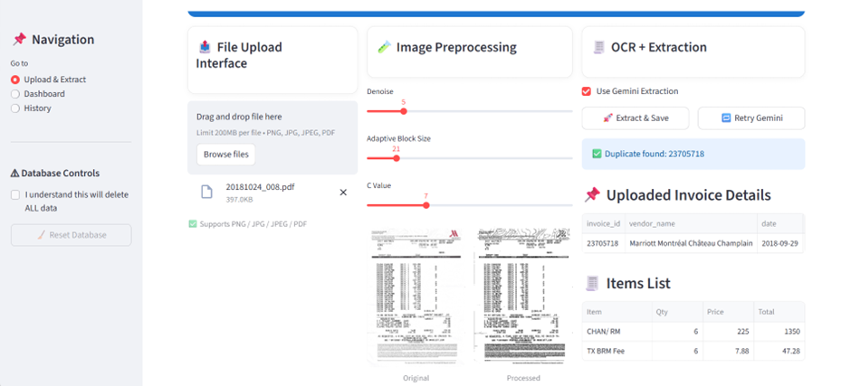
Conclusion and Outputs
Conclusion
Project automates invoice digitization using OCR + AI
Provides reliable storage + analytics for expense tracking

Slide 10
